Slide 1
Summer School Mexico 2024
Yucatan
September 1st – 14th

Slide 2
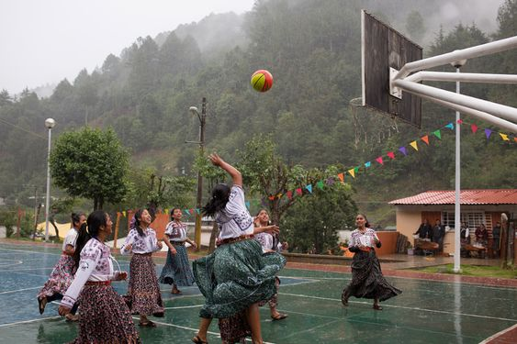
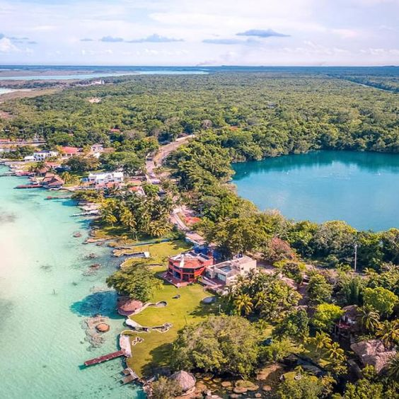
Content
Hosting Institution
Goals of the Summer School
Program/Itinerary
Important information
Discussion/ Q&A

Slide 3
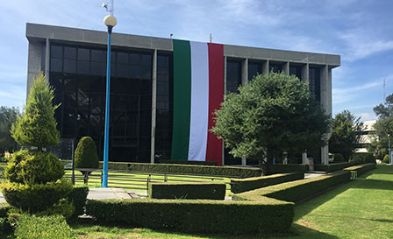

Hosting Institution
Agriculture, Forestry, Fishery
Master and PhD degree
Educational offer and focus overview: https://www.colpos.mx/cp/educacion/oferta-educativa

Slide 4
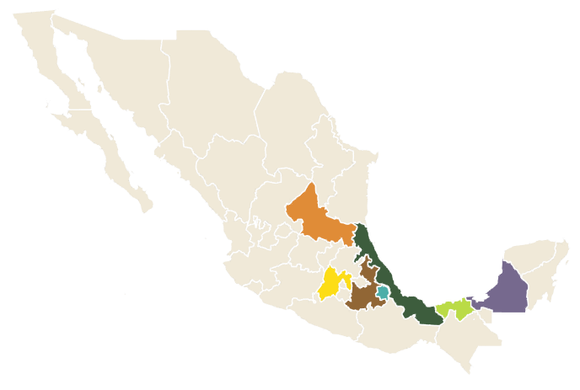
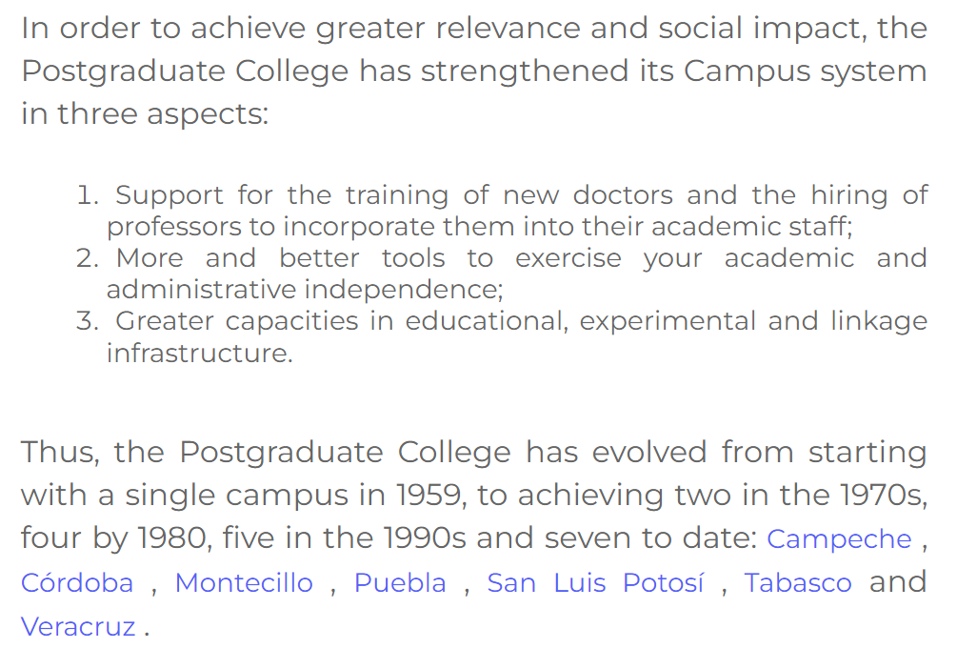

Slide 5
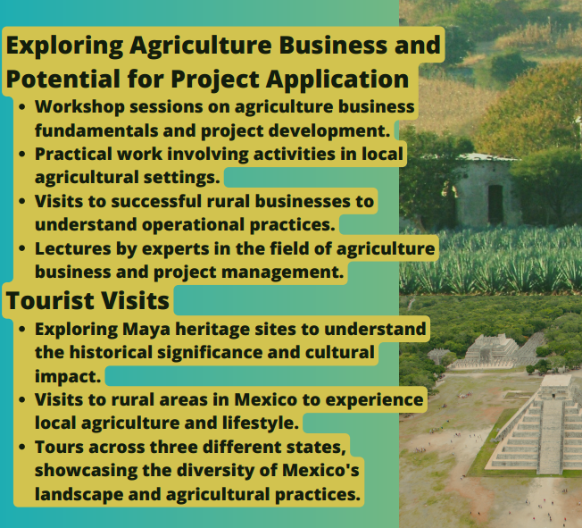
Goals
Erasmus + Projects; Horizon Europe
Determining the potential call and structuring it during the workshop

Slide 6
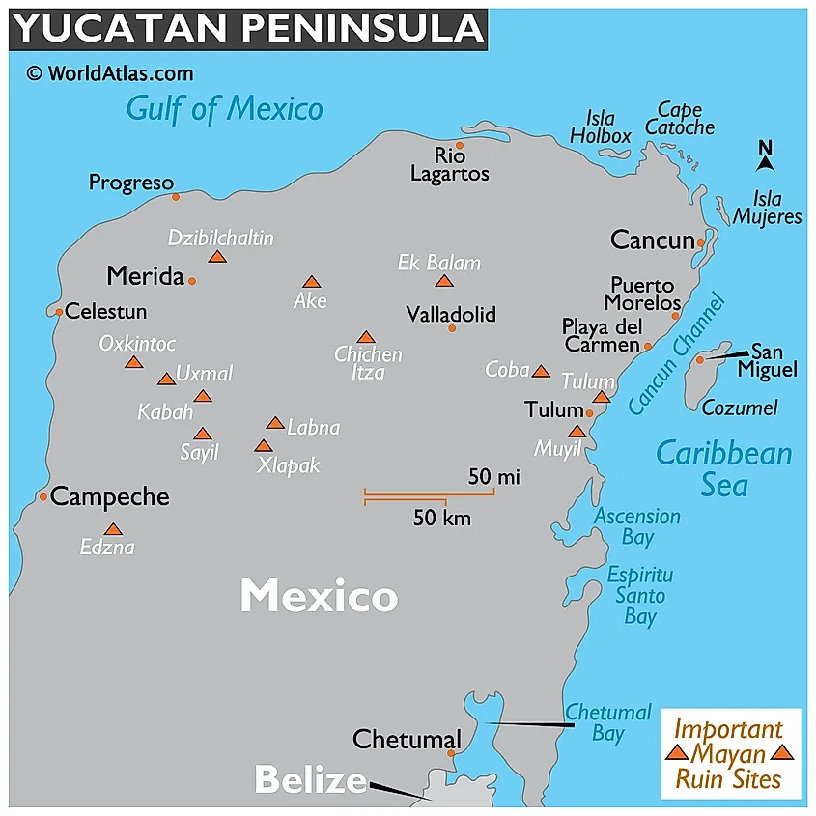
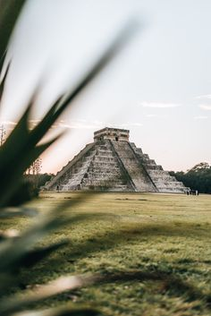
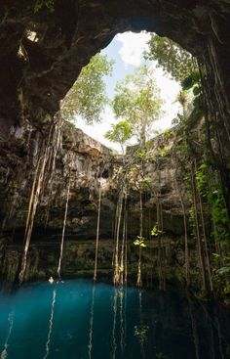
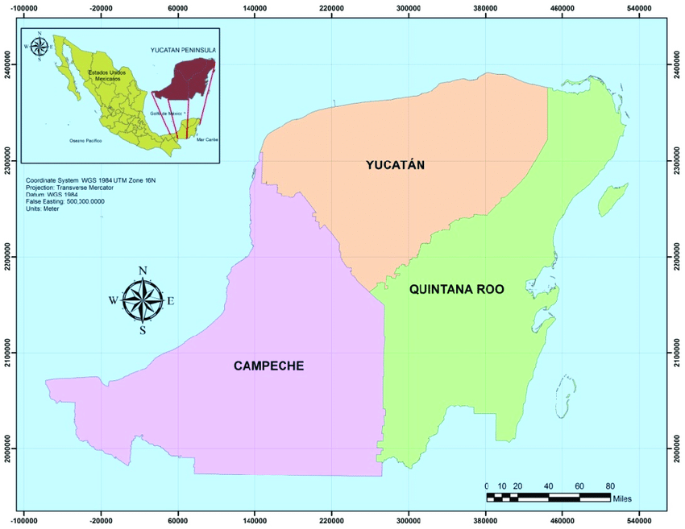
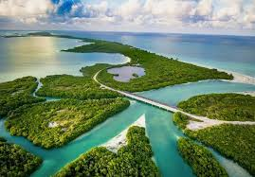
Yucatan Peninsula

Slide 7
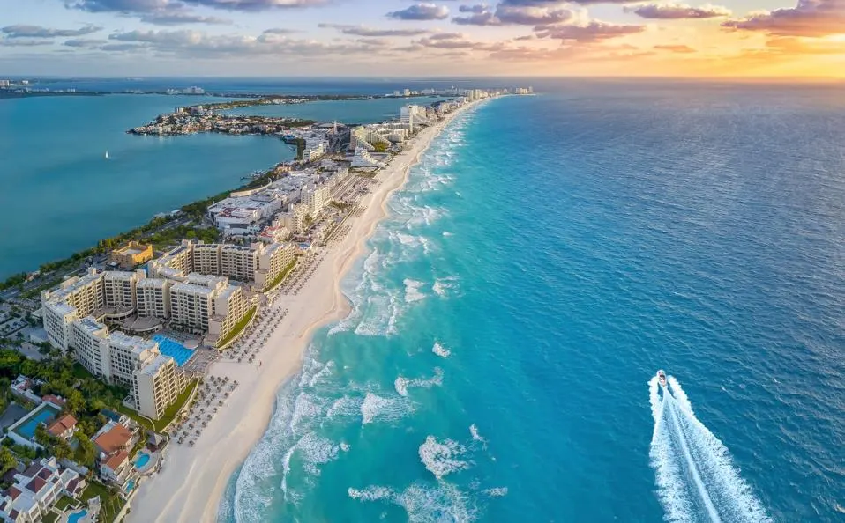
September 1 - CANCUN
Meeting at Cancun Airport or at the Accommodation
Pick-up at arranged time (depending on your arrivals)
Accommodation and free day for relaxation
Dinner
City center visit

Slide 8
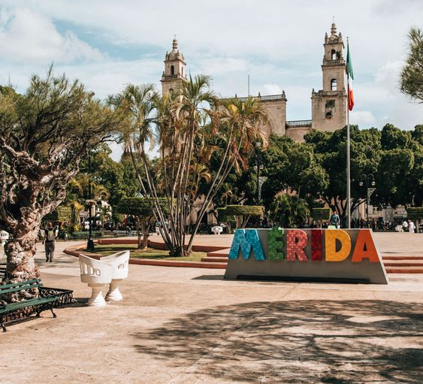
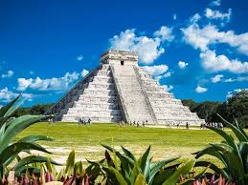
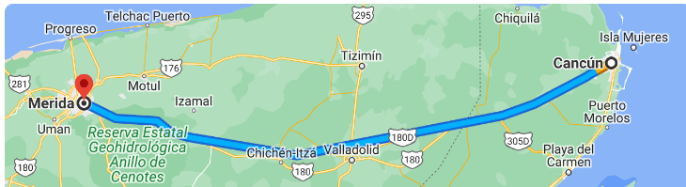
September 2 - MÉRIDA
Arriving to Merida
Accommodation
Free time, explore the city
Dinner
Stops and visits on the way ?

Slide 9

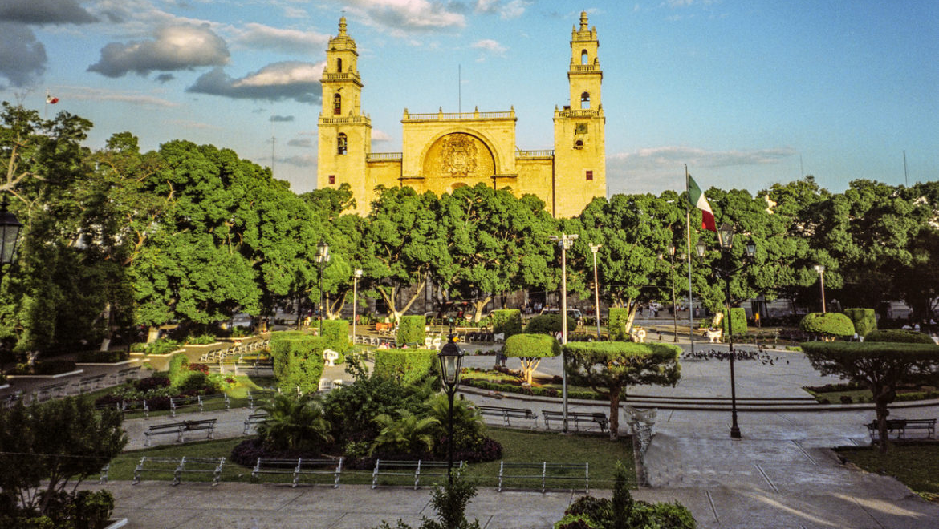

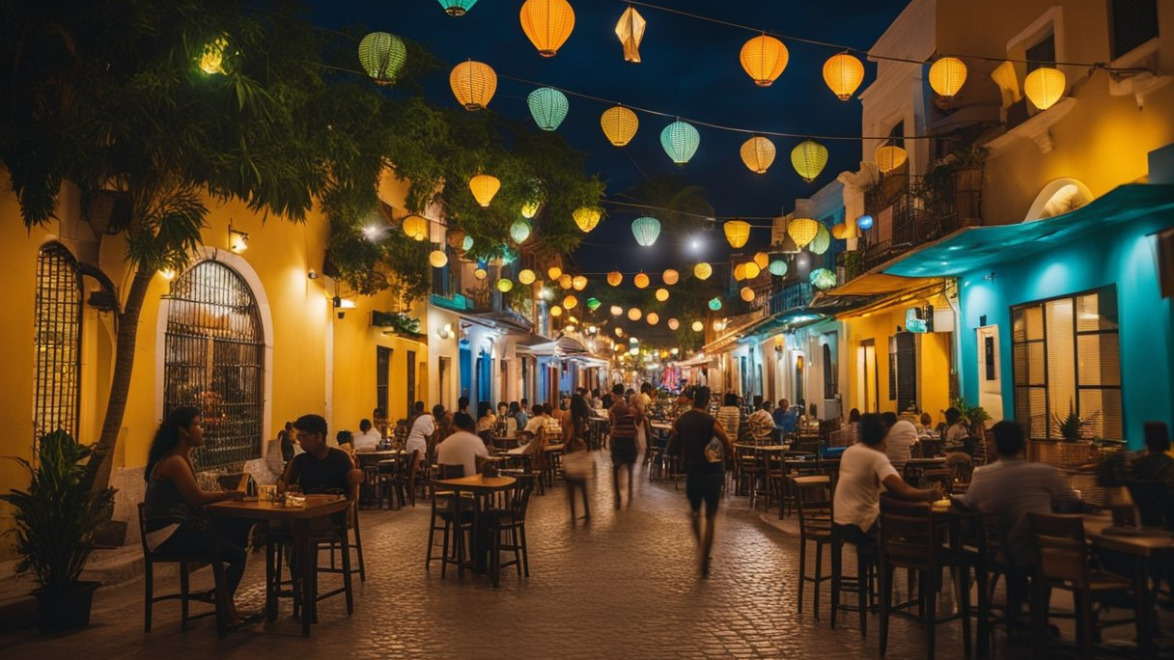
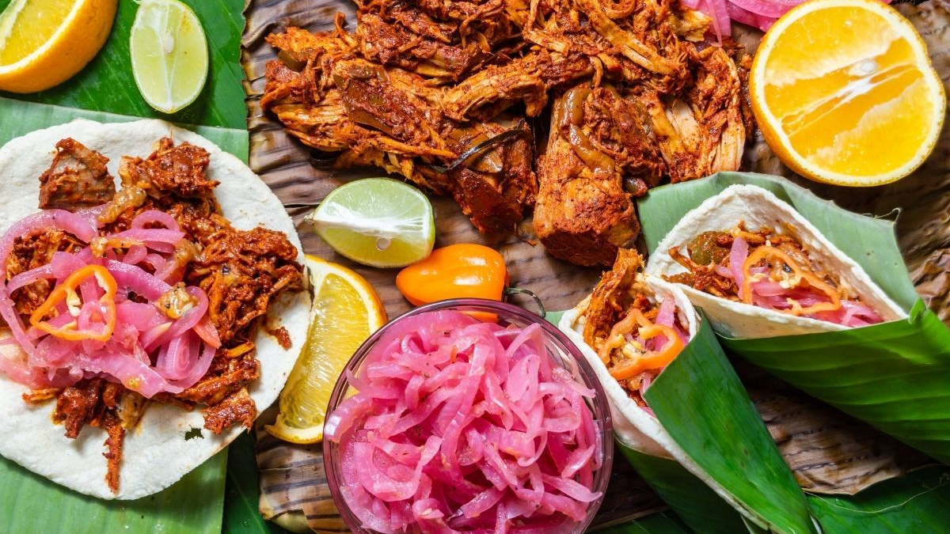
September 3 -MÉRIDA
Visiting University of Yucatan
Meeting with representatives
Lectures, Discussions
Free afternoon and evening

Slide 10
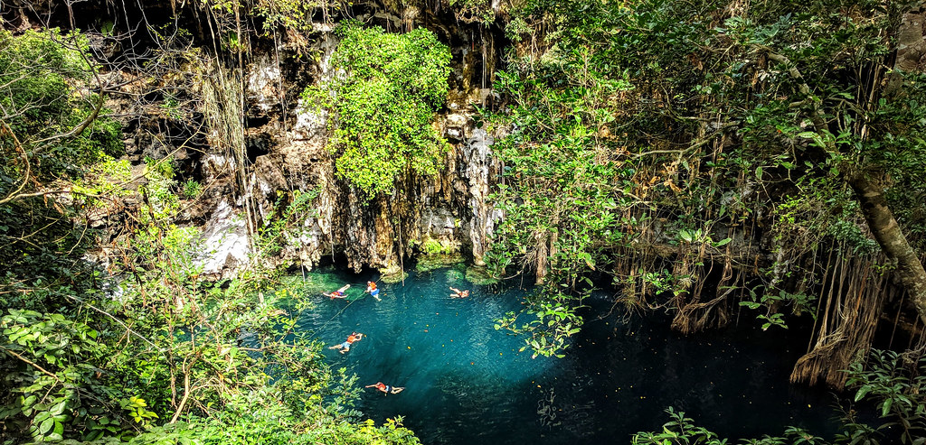
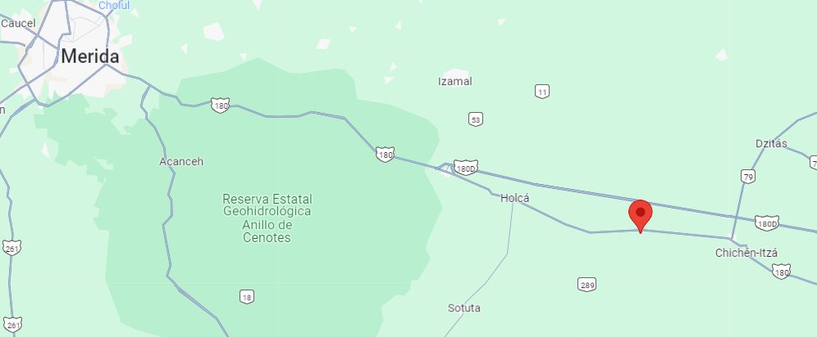
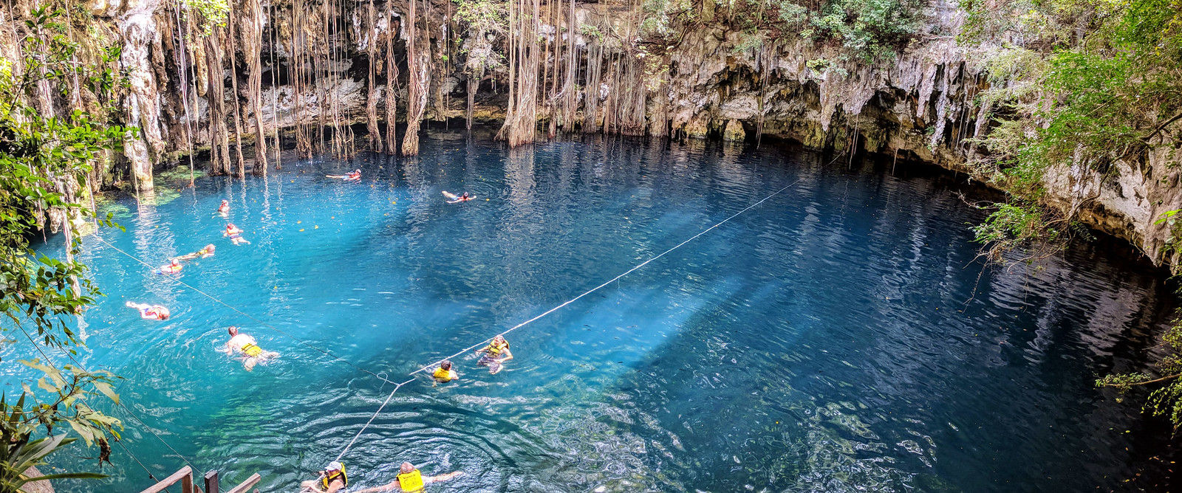
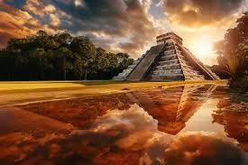
September 4 - YODZONOT/ CHICHENITZA
+ community experience

Slide 11
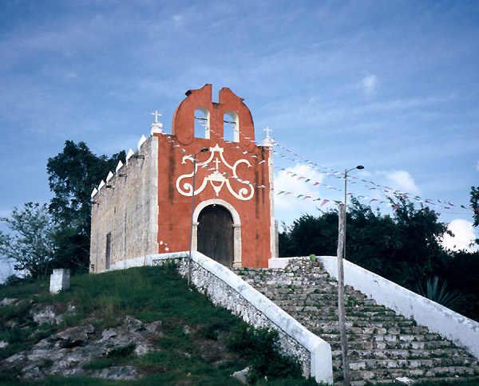
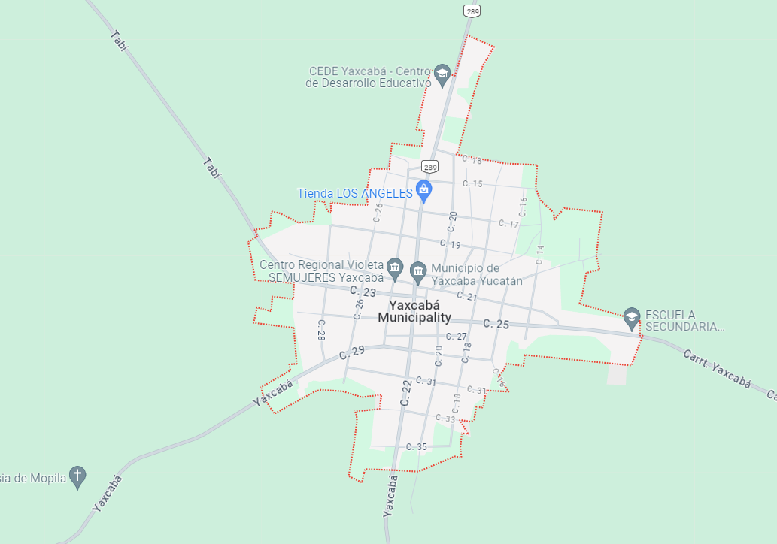
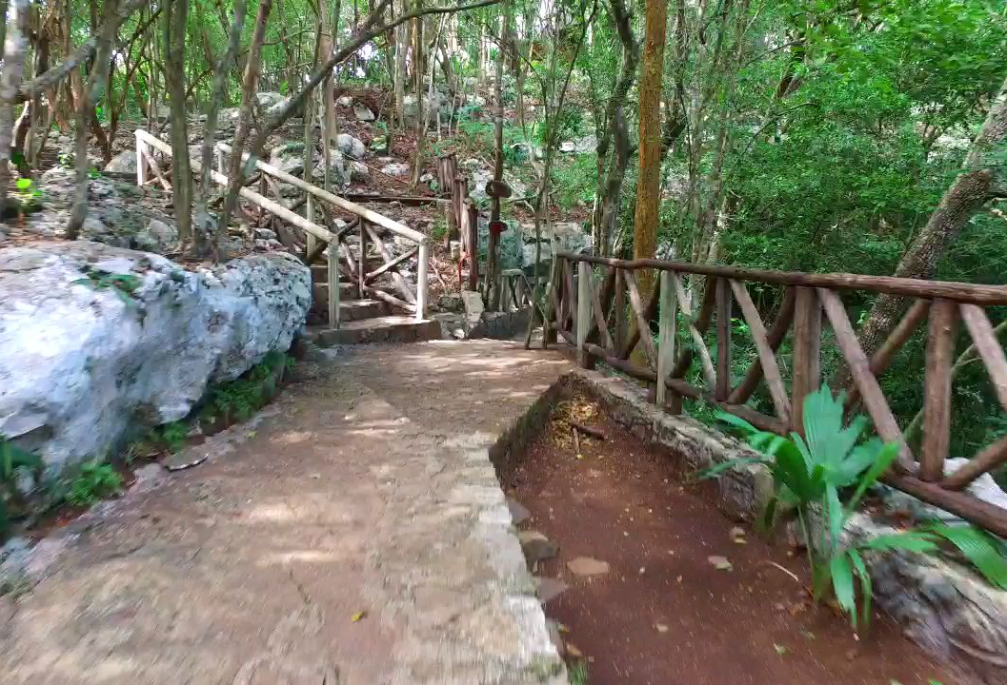
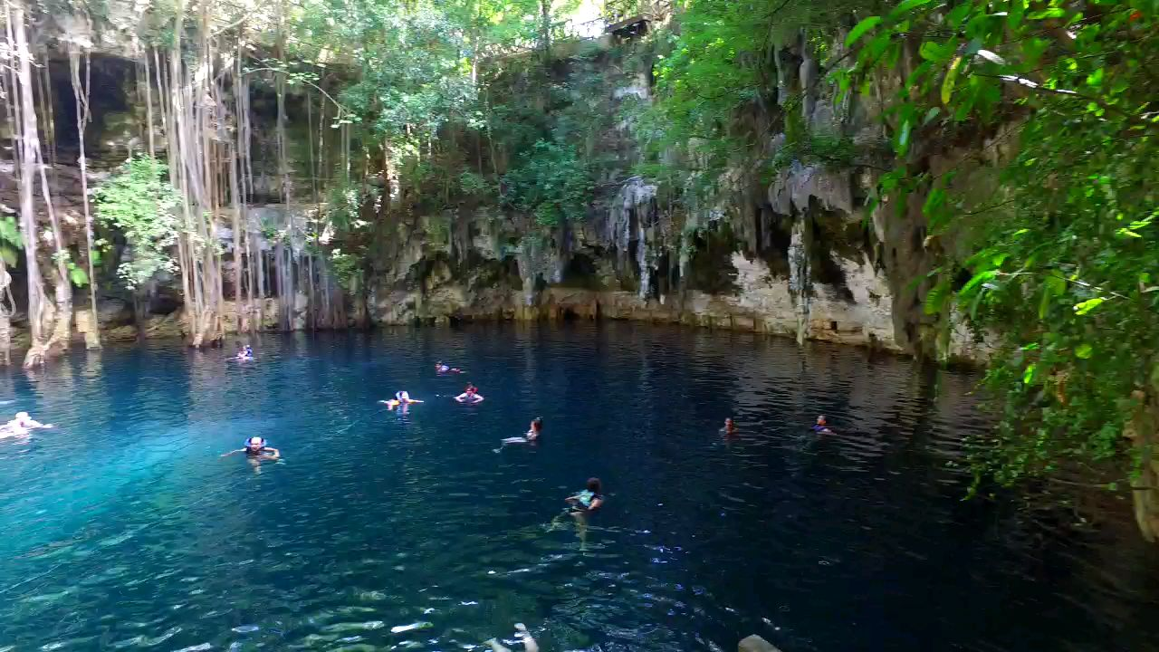
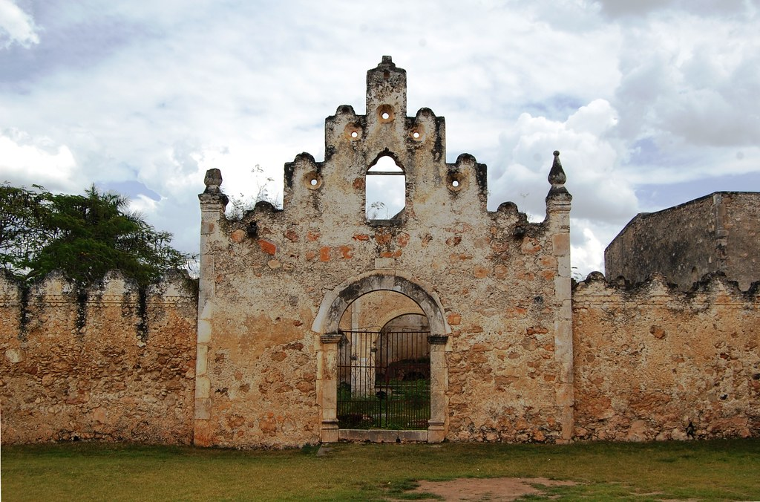
September 5 - YAXCABA
Community experience
Argo food chain
Exploring the potential for community development

Slide 12
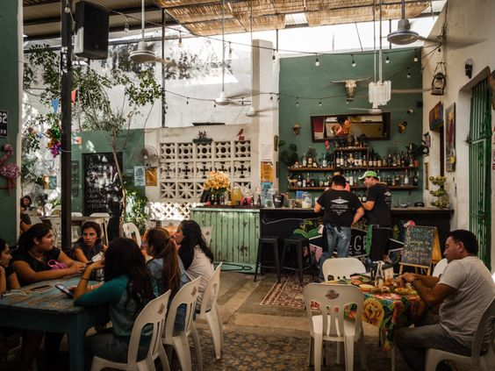
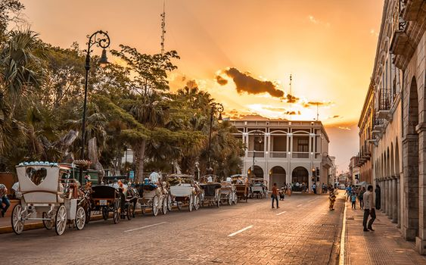
September 6 -Mérida
Return to Merida
Wrapping up the (so-far) activity, making the further plan
Discussing the potential for project proposal/ Workshop activities
Free afternoon and night

Slide 13
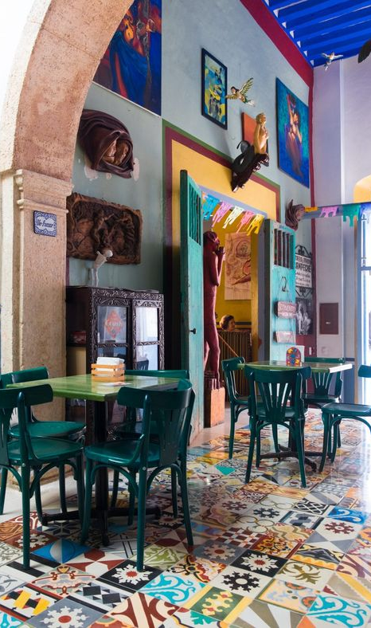
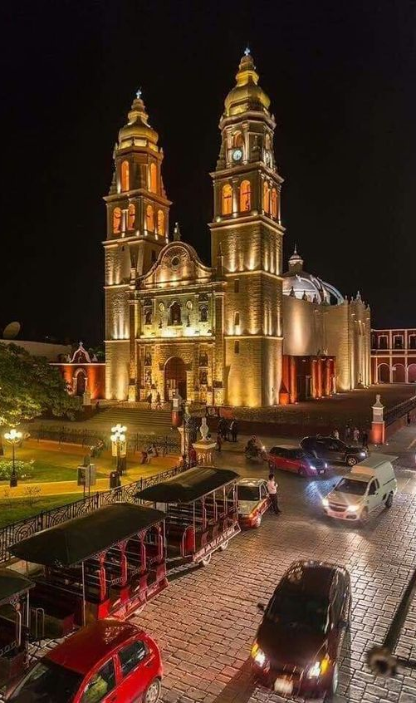
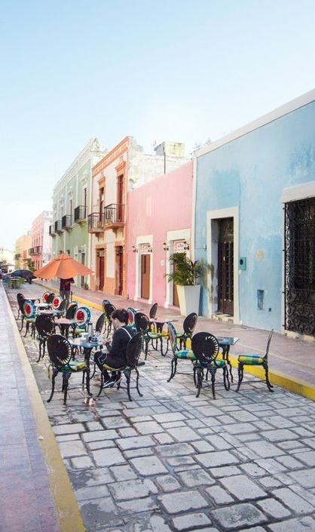
September 7 -Campeche
Project discussion
Lecture on selected agro-commodity, or beekeeping or (…)
Exploring the city of Campeche

Slide 14
September 8 -Mérida
Return to Merida
Wrapping up the (so-far) activity, making the further plan
Discussing the potential for project proposal/ Workshop activities
Free afternoon and night

Slide 15
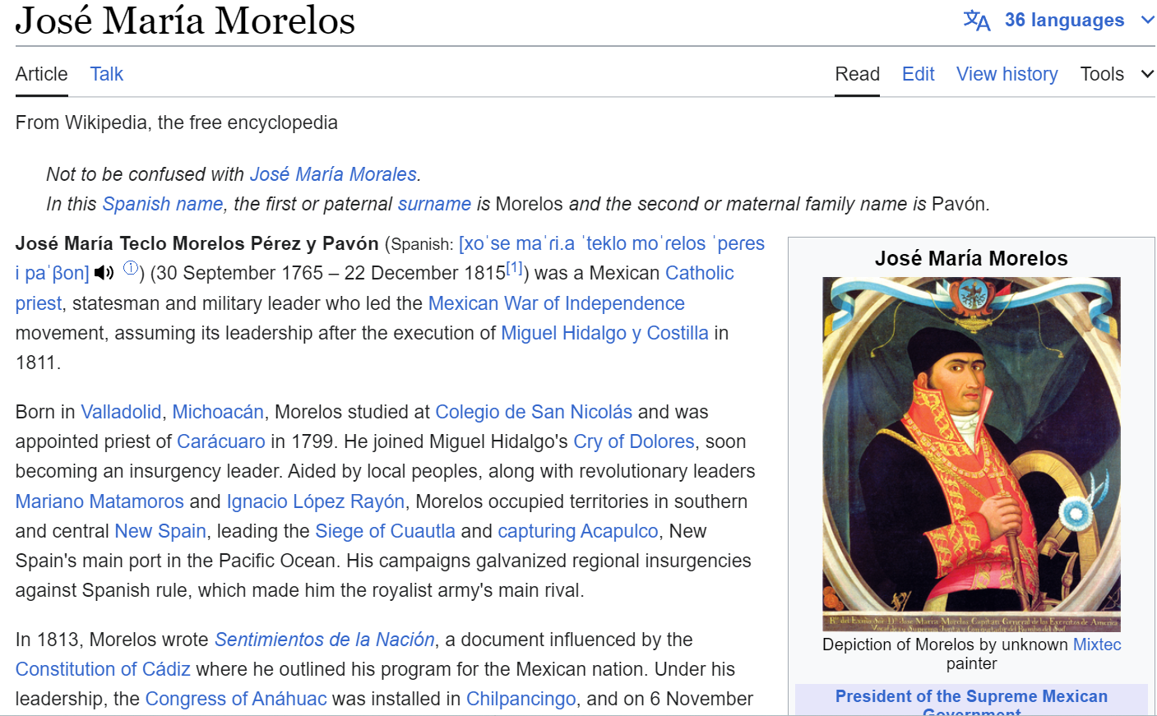
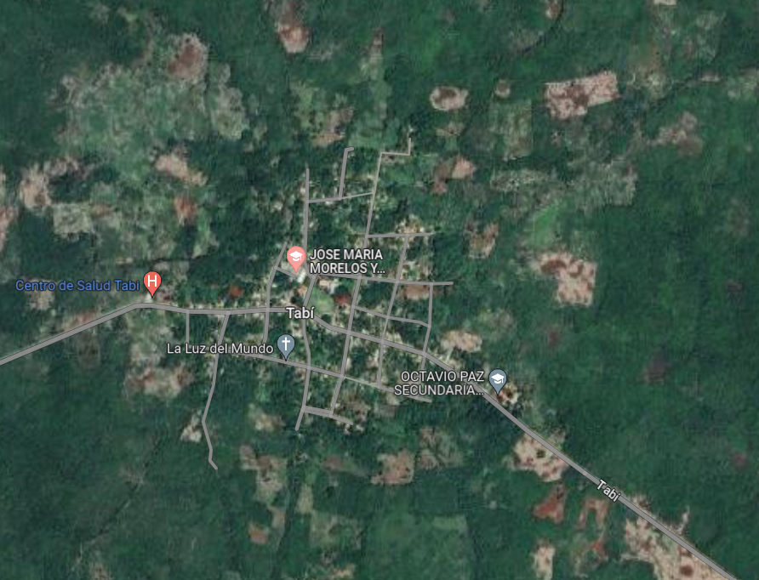
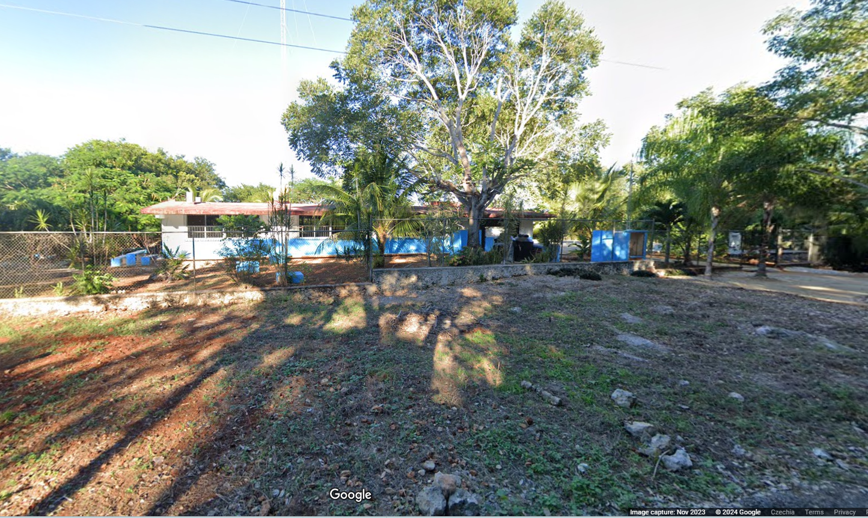
September 9 -Jose Maria Morelos
Google Street View: https://www.google.com/maps/@20.5997483,-88.8998149,3a,75y,234.05h,69.89t/data=!3m7!1e1!3m5!1smONpFDGVdpNgvZZtlCe9tQ!2e0!6shttps:%2F%2Fstreetviewpixels-pa.googleapis.com%2Fv1%2Fthumbnail%3Fpanoid%3DmONpFDGVdpNgvZZtlCe9tQ%26cb_client%3Dmaps_sv.share%26w%3D900%26h%3D600%26yaw%3D234.05417396535128%26pitch%3D20.111295031965284%26thumbfov%3D90!7i16384!8i8192?coh=205410&entry=ttu

Slide 16
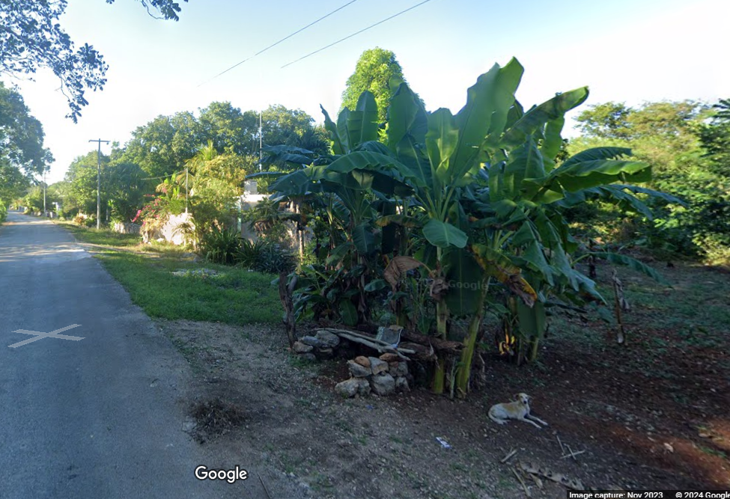
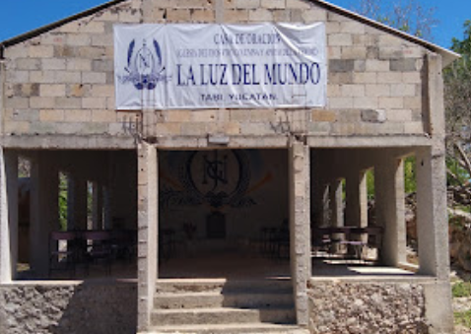
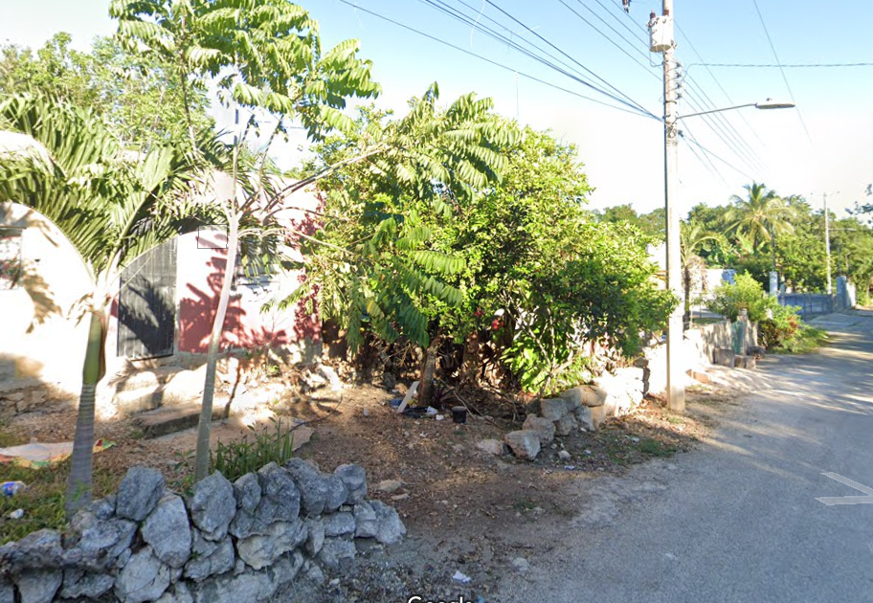
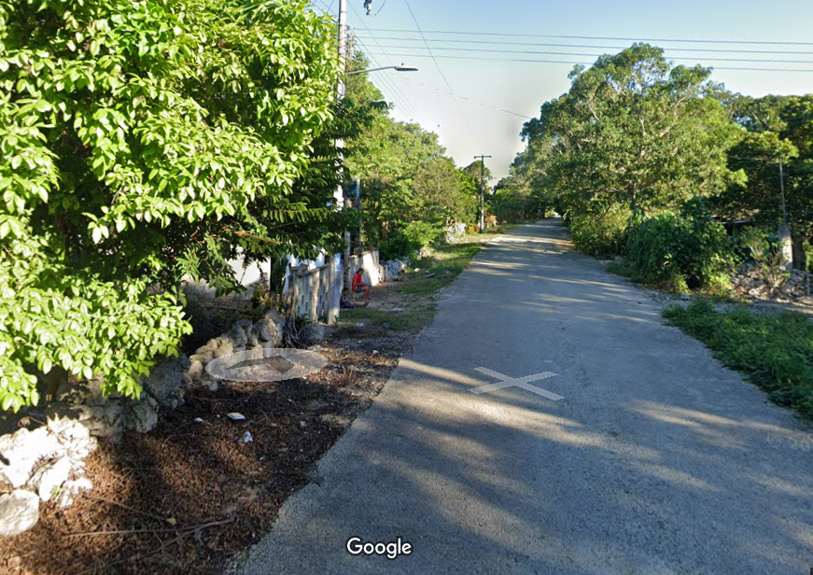
September 10 - JMM
Community experience
Project discussions
Connecting with locals
(Questionnaires, research, interviews,…)

Slide 17
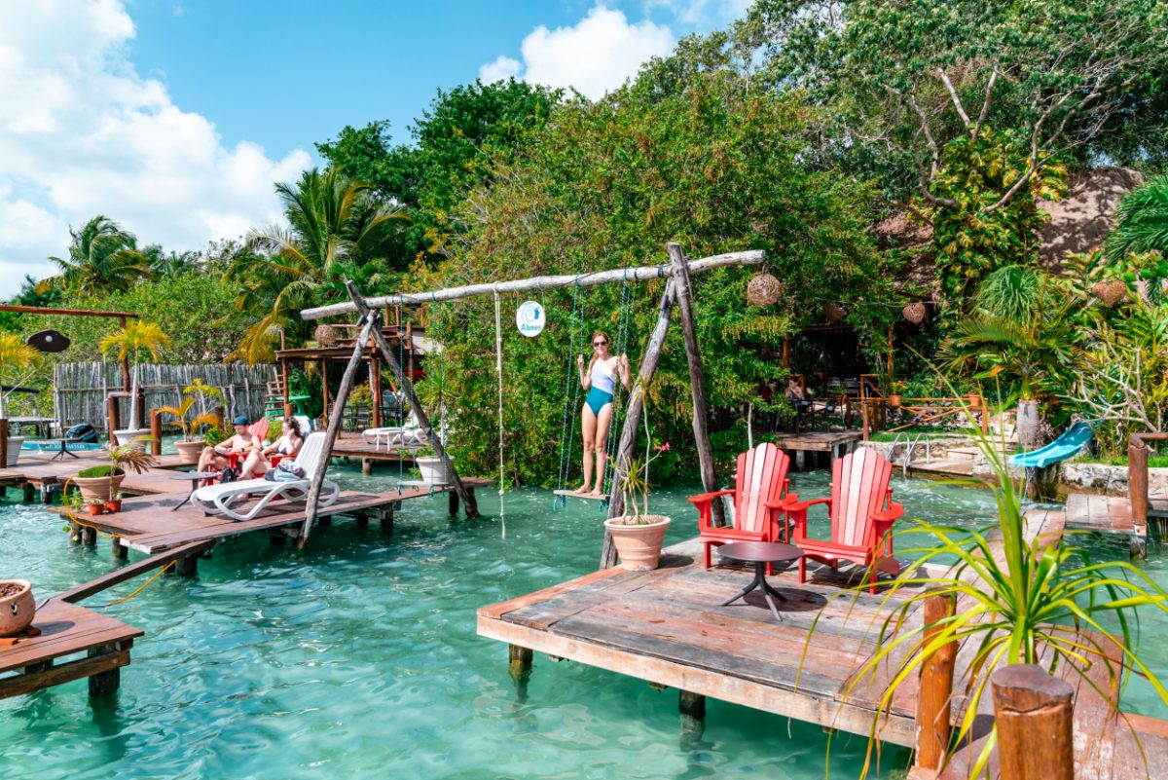
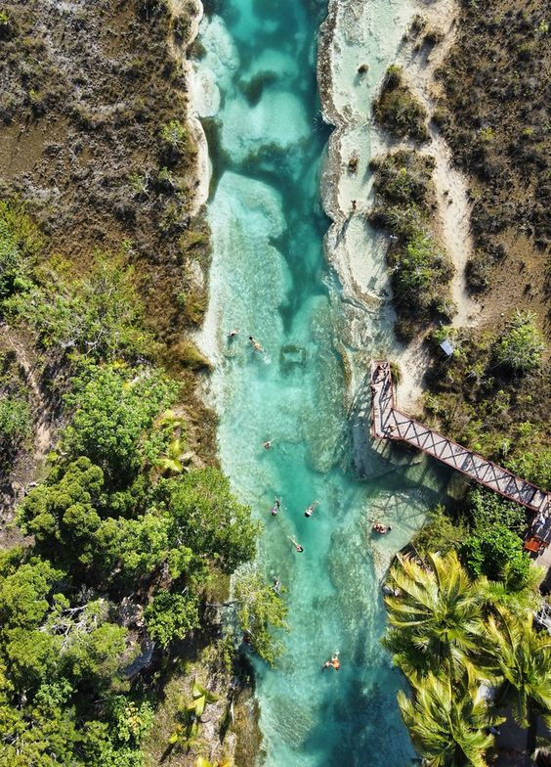
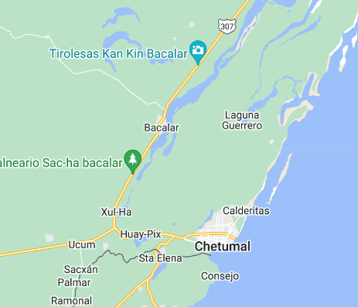
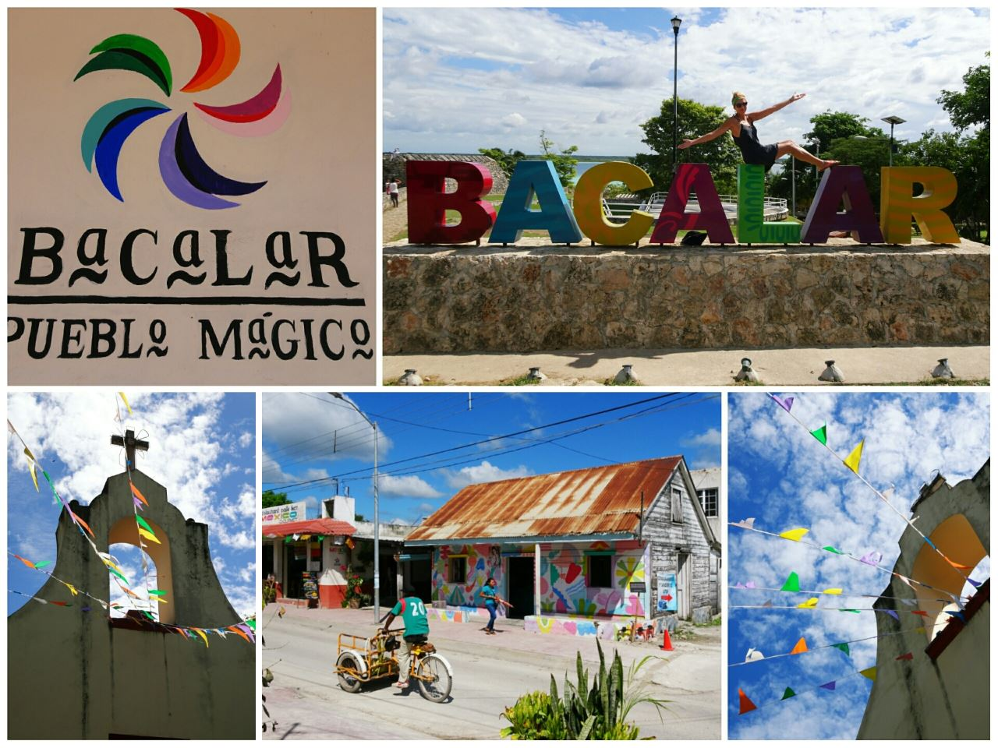
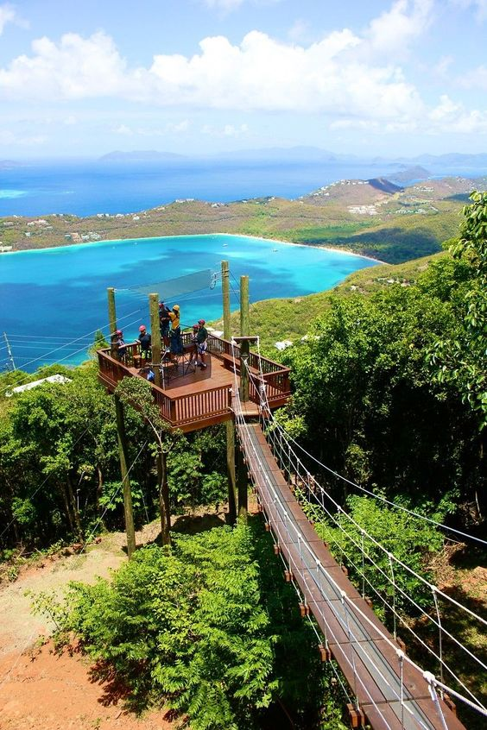
September 11 - Bacalar

Slide 18
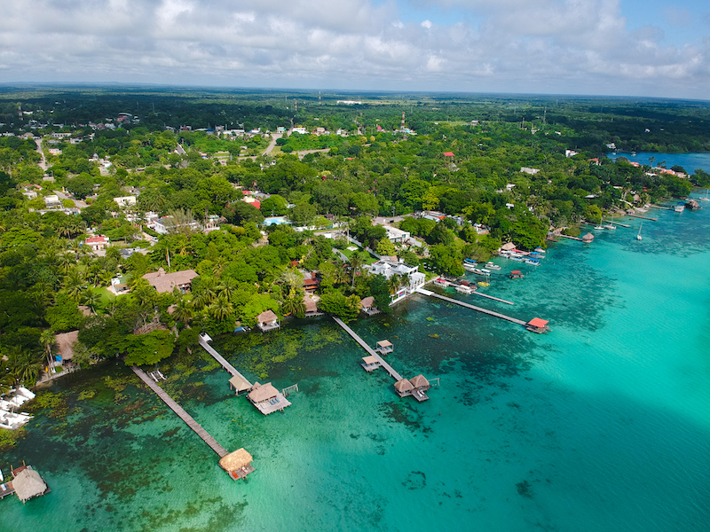
September 12 – Bacalar
Project work ;)

Slide 19
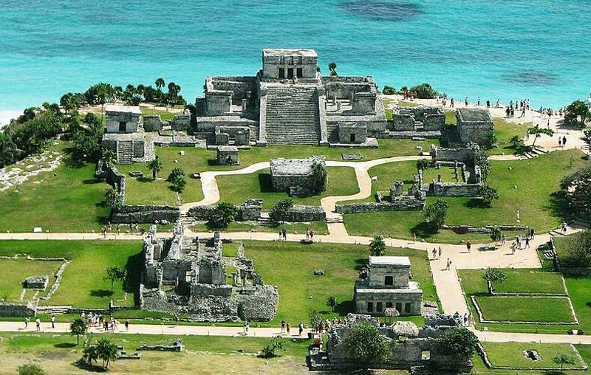
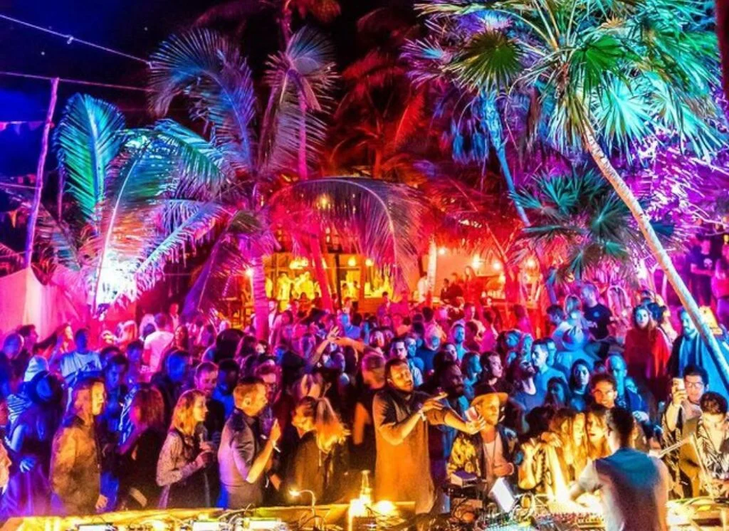
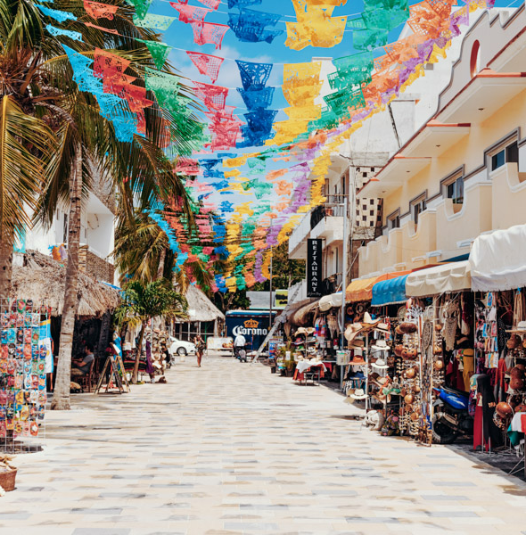
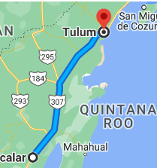
September 13 – Tulum, possible trip to Akumal

Slide 20
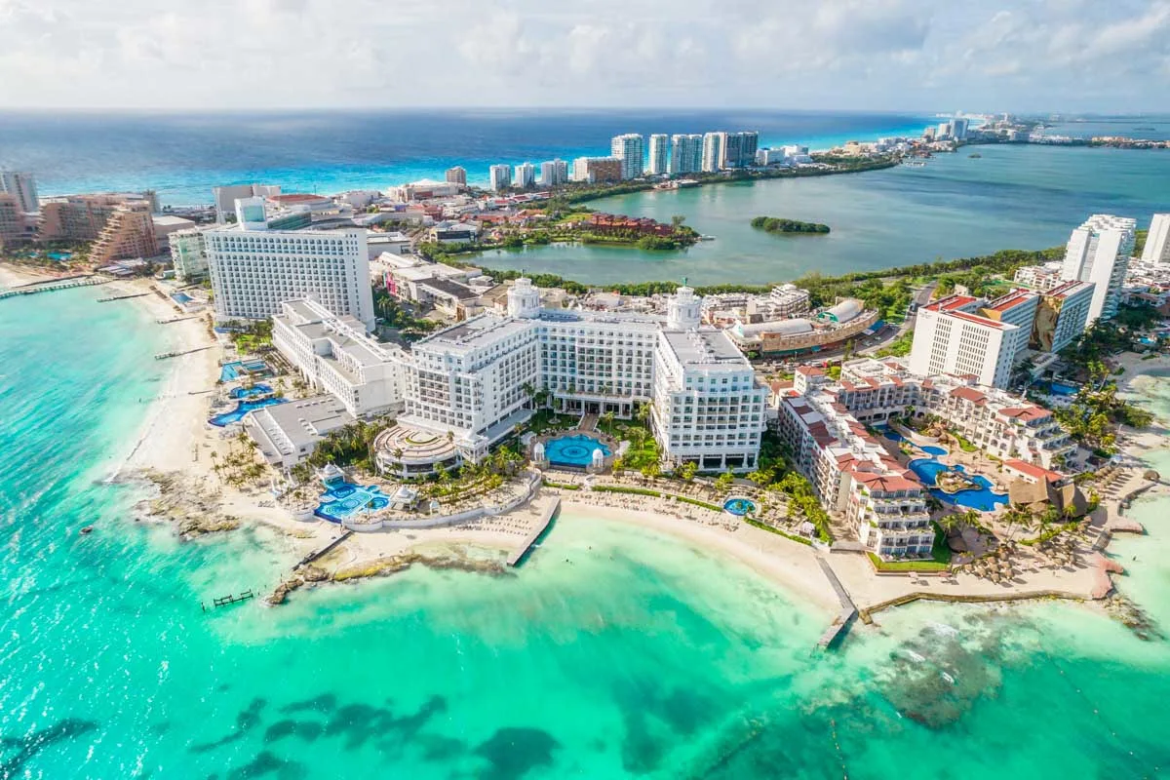

September 14 - Cancun
Return to Cancun
Free time, beach, party, Isla Mujeres,..

Slide 21




OPTIONAL: September 15 – 16 (la)Fiesta
The Independence Day
You can book accommodation on your choice, travel home, or travel within/to another country
Possibility of booking accommodation together and celebrate it together
Not included in the fee, official activities finish on 14th, and all arrangements are upon agreement

Slide 22
Important Information
Dates: September // 1-14
14 participants
Participation fee: 1300 EUR
INCLUDED
Accommodation
Transportation (van rental, gas, road tolls)
One meal daily
EXCLUDED
Other meals
Entrance tickets (e.g., archeological site)
Flight tickets
Scholarship for PEF students:
10 000 CZK
Application deadline:
26 April send your CV and motivation letter to melezinkova@pef.czu.cz (possible online or in-person interview will follow)
Interviews and Evaluation :
from 26 April
Announcement of the list of participants (and substitutes):
3 May
Participation fee payment:
26 May (deposited to the university bank account)
Final meeting before start (or online call):
August

Slide 23


Discussion/ Q&A
Luggage, clothes
…
Vaccination
Insurance
Pocket Money (Food, Entrances,..) – min 500 Eur
Chichen Itza Entrance Fee is $614 MXN = 35 Eur

