Slide 1
The smartest solution to student’s flat sharing

Slide 2
Flat share with erasmus students!
Smart-Studios is making accommodation for Erasmus students in Athens easier than ever!
We offer a full package to incoming Erasmus students for their studies. With a warm welcome and a serious sense of responsibility we make it our first priority to provide a safe and relaxed staying.
For students who are new to Athens we will make it as easy as it gets to find their ways through to the everyday life in our city.
Flat searching is always more successful when someone with experience is here to help.
The smartest solution to student’s flat sharing

Slide 3
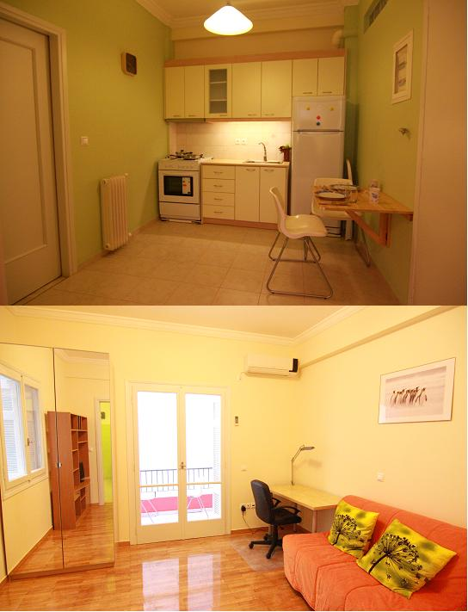
First come, first served
Good quality flats in Athens are rented out on the spot, and it is crucial that your reservation is completed immediately upon making your choice. The rule of "first come, first served" applies and, if you are not prepared, you might find yourself in a "last minute" situation trying to find an accommodation of your liking in very few days.
The smartest solution to student’s flat sharing

Slide 4
Hurdles…
There are several hurdles in finding short lets and furnished accommodation in Athens.
Greek house owners make contracts for the minimum period of one or two years, not for five or four months (main reasons are taxation and the hassle of managing short lets).
In addition, a furnished flat is not common in Athens because there is not enough demand as most of the tenants own their furniture.
On the other hand Greek land owners do not sign a short tenancy agreement as they prefer to offer their property to Greek Students who accept to sign a four years contract.
Greek students also pay for their bills and every other expense that building may need (cleaning service, central heating expenses, lift maintenance etc. by proportion to the flat size).
The majority of Greek houses don’t offer free internet and you have to pay extra in order for you to find by yourself a way to have internet.
The smartest solution to student’s flat sharing

Slide 5
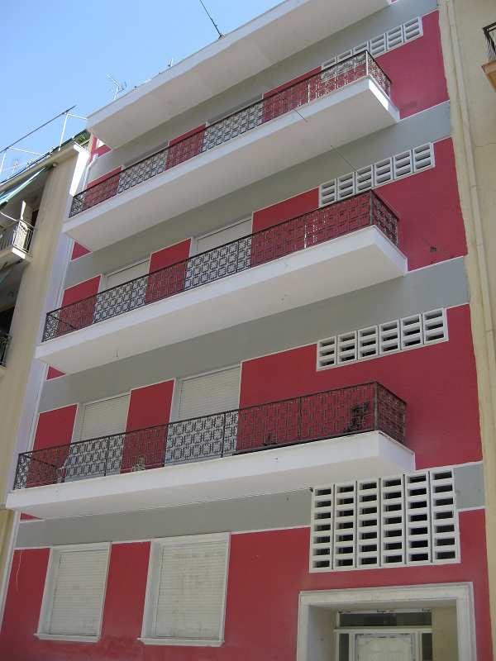
Make your life easier
We make it even easier for you so that you do not need to bother with all these as everything is included in our rents.
We look into your needs with the view to offer a handy all-in-one package which encompasses all needs that a foreign student will look to cover.
We also work together with certain Erasmus communities in Athens from different universities so that we understand better the needs and relief the Erasmus student from the stressful flat search.
The smartest solution to student’s flat sharing

Slide 6
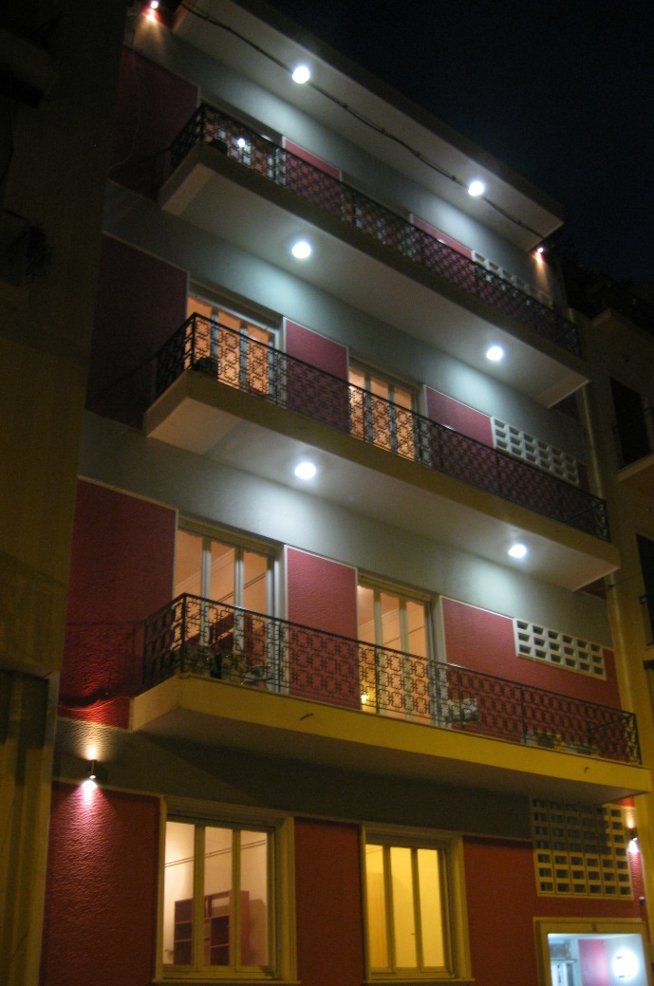
“I want smart-studios”
All information you need is on the internet (www.smart-studios.gr), or you may come across us through your university, either way you will have to choose an available flat of our building on the web, and make a reservation by sending us an email to info@smart-studios.gr, or by phone on +306946954697 (mobile) and +302106711215 (landline).
Next step is to put the flat off the market so you need to advance, via a bank wire, an amount as a deposit equal to one month's rent.
After arranging for your reservation, you can also choose if you would like to have a roommate from your country or other country if you want to practice your English and if the adjacent room is empty. Every apartment is ideal for two roommates.
The smartest solution to student’s flat sharing

Slide 7
welcome
When you arrive in Athens, we pick you up from the airport and we drive you to our premises if you chose so - just let us know by email.
If you want to cancel your reservation after placing the deposit, you can do so as long as it is one month before your starting date of the tenancy period in which case you will get back the full amount of the deposit. If your cancellation takes place between fifteen days and twenty nine before the starting date you will get back half the amount of the deposit while if it is less than fifteen days you are not entitled a refund.
The smartest solution to student’s flat sharing

Slide 8
Booklets and maps
There are all sorts of booklets and maps in each flat to help you out with your staying in Athens, (transportation, sightseeing, easy cooking recipes, mini map of the area with shops and all sorts of amenities, Erasmus events etc.).
There are also manuals for each electrical appliance in the flat.
The smartest solution to student’s flat sharing

Slide 9
Group of technicians/doctors
We have a group of contractors providing maintenance services in the apartments and communal areas of the building (indicatively electricians, hydraulics, locksmiths).
Smart-Studios is also a member of "SOS Doctors", a group of doctors of all specialties providing 24/7 consultation and emergency on-site visit.
There is also a private insurance running for all Erasmus students living in Smart-Studios provided by ATE Insurance Company (www.ateinsurance.gr ) covering any medical expenses from accidents that may occur in the building during the staying of the student (it should be owner’s fault, bad construction etc., in order for the company to cover the expenses).
The smartest solution to student’s flat sharing

Slide 10
benefits
Free high speed internet
Proximity 4 minutes walk to metro station
Air condition
Autonomous heating
Security entrance doors
CCTV in public areas
Oak floors
Fully furnished by IKEA
All electrical appliances (LCD TV connectable to PC, oven, refrigerator, washing machine etc.)
Towels, linens, utensils, kitchenware
The smartest solution to student’s flat sharing

Slide 11
“Basic Terms and conditions”
The tenancy agreement will be signed between you and the owner of Smart Studios after your arrival in Athens, usually the same day you visit the flat. We will also send you by email a copy of the contract beforehand if you request so.
There are no other costs for you to pay and all other bills are included in the rent. However, there are agreed limits of consumption of water, electricity and heating for each person. Although not common, in case of excess use of water, electricity or/and heating as indicated by the charges shown in the respective bills, it will be your obligation to share with your roommate the costs of the excess consumption according to the pre-agreed levels which will be clearly written in the contract.
The smartest solution to student’s flat sharing

Slide 12
“Basic Terms and conditions”
A student can also choose to rent a flat by him/herself (without sharing) but in that case he/she will have to pay double the amount of the rent (not recommended as rooms are quite spacious for a student).
After signing the contracts you will have to pre pay the rents for the months you are planning to stay.
Should you not able to pay the total amount please do email us or call us and we might be able to come up with a special arrangement for you.
The smartest solution to student’s flat sharing

Slide 13
FInances
The Erasmus period should be from 15th of September up to 14th of February and 15th of February up to 15th of June.
If a student wishes can stay longer and we will come up with another arrangement for him/her.
The monthly rent starts from 275 euros (silver offer) to 320 euros (gold offer) per student (room).
For any further information contact us:
info@smart-studios.gr
+306946954697 (mobile)
+302106711215 (landline)
The smartest solution to student’s flat sharing

