Slide 1
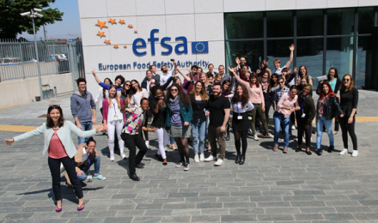
Traineeship programme
University degree
B2 level in English
Have never been an EFSA trainee or employed by EFSA
EU citizen and non-EU citizen
Eligibility
Areas of Interest
Science
Business Services
Communi cation
Duration: up to 12 months
Monthly maintenance grant = €1,150
Working language: English
Intake of around 70 trainees in all EFSA units
Programme
23 July 2018
Applications deadline
1 November 2018
1st in-take
1 February 2019
2nd in-take
4 June 2018
Call published
Selection Process
Screening of candidates
Interviews
traineeships@efsa.europa.eu
careers.efsa.europa.eu
Notes:
The Selection Procedure
Submission of applications: instructions in the call and on EFSA’s website
Screening of candidates: applications screened / assessed by EFSA Units
Invitation to interview: selected candidates invited to phone or Skype interview
Positive outcome of selection process: placement offer – reserve list
Confirmation of traineeship: following submission of required documents

