Slide 1
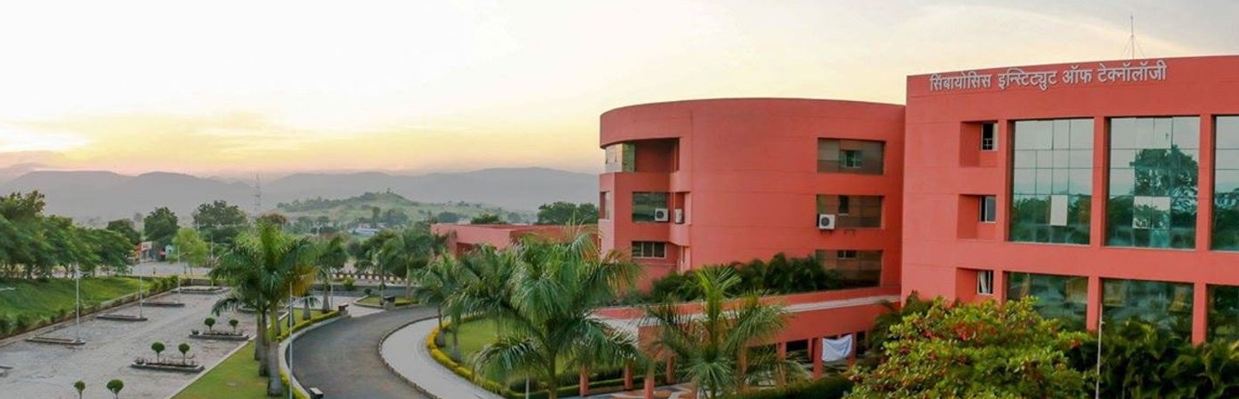

DIGITAL MARKETING PROPOSAL

Slide 2

TABLE OF CONTENT
About SIT
Programmes Offered
SIT Features

Slide 3
ABOUT SIT

Slide 4

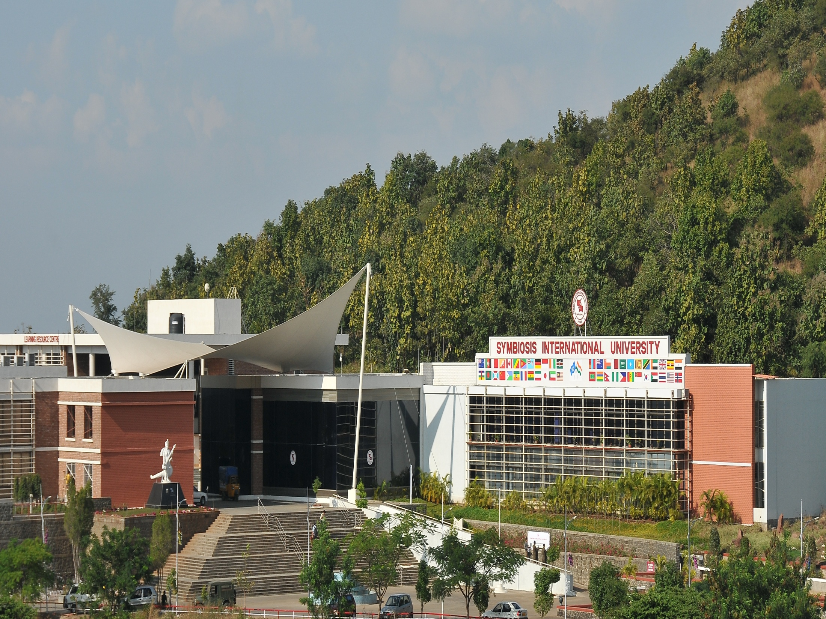
A Constituent of
Symbiosis International University

Slide 5
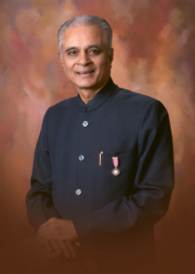

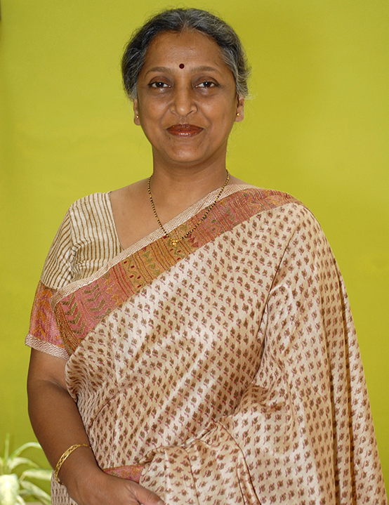
Leadership @ Symbiosis
Dr. S.B. Mujumdar
Padma Bhushan and Padmashri
Founder and president,
Chancellor,
Symbiosis International University
Dr. Vidya Mujumdar
Pro Chancellor and Principal Director,
Symbiosis International University
Dr. Rajani Gupte
Vice Chancellor ,
Symbiosis International University

Slide 6
Faculties under SIU
Faculty of Engineering
Faculty of Law
Faculty of Management
Faculty of Health and Biological Sciences
Faculty of Humanities & Social Science
Faculty of Media and Communication
Faculty of Computer Studies
Faculty of Architecture and Design
Notes:
ADD:- Organizational Behavior, Enterperurship, Economics

Slide 7


WHO ARE WE ?
PIONEER ENGINEERING INSTITUTE OF SYMBIOSIS
A DECADE OF LEGACY
AICTE Approved
Re-accredited by NAAC with 'A' Grade

Slide 8



OUR RANKINGS
Amongst TOP PRIVATE Engineering colleges in The West Zone by
India Today 2018 survey
Amongst TOP PRIVATE Engineering colleges in The Country by India Today 2018 survey
Amongst TOP PRIVATE Engineering colleges offering Best Average Annual Salary by India Today 2018 survey

Slide 9
PROGRAMMES OFFERED

Slide 10





B.Tech, M.Tech and PhD Programmes
MECHANICAL
COMPUTER SCIENCE
ELECTRONICS & COMMUNICATION
BTech: Intake: 120
MTech:Intake: 18
BTech: Intake : 180
MTech: Intake : 24
BTech: Intake : 120
MTech: Intake : 18
CIVIL
INFORMATION TECHNOLOGY
BTech: Intake : 60
MTech: Intake : 18
Intake : 60
Over 170 research scholars are pursuing PhD under Faculty of Engineering

Slide 11
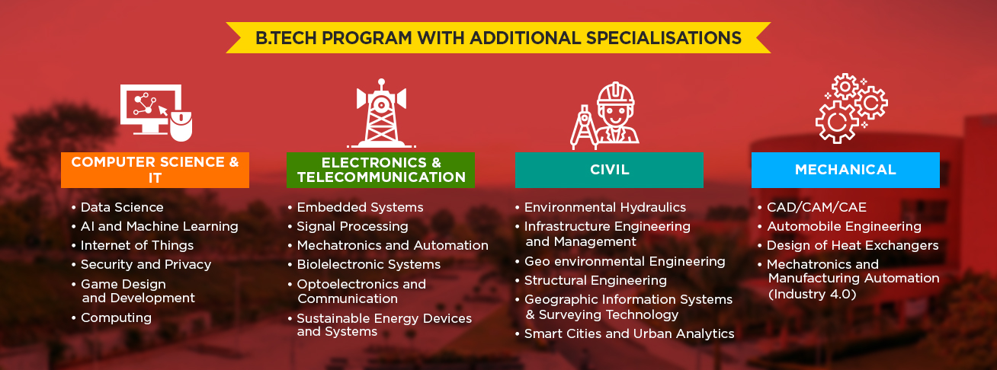

Slide 12
SIT FEATURES

Slide 13
Internationalization
Strong Industry Connect
Internships
Internships
Option To Pursue Diploma In Business Management
SIT
FEATURES
Multicultural and Vibrant On-Campus Life
Focused Skilled Development Activities
Short Term Certification Courses
Holistic Engineering Curriculum
B.Tech Degree With Honors
Conducive Research Environment

Slide 14









Innovative Curriculum
Tinker Lab
Design Thinking
Critical Thinking
Foreign Language
Creative Thinking
Organizational
Behaviour
Entrepreneurship
Economics
Notes:
ADD:- Organizational Behavior, Enterperurship, Economics

Slide 15
Experiential Learning
Project Based Learning
Major Project
Global Immersion Program
Service Learning
Flexi Credits by Industry
Internships
Notes:
ADD:- Organizational Behavior, Enterperurship, Economics

Slide 16
Industry Connect
Specializations in collaboration with industry
Internships
Consulting
Industry defined projects
Industry sponsored laboratories
Faculty sabbaticals in industry
Notes:
ADD:- Organizational Behavior, Enterperurship, Economics

Slide 17
Internationalization
Global Immersion Program
Flexi Credits
Study Tours
Collaborative BTech , MTech and PhD programs
Scholars in-Residence
Co-supervisors for research scholars
Collaborative Funded Projects
Joint Researchers
Notes:
ADD:- Organizational Behavior, Enterperurship, Economics

Slide 18

Research Clusters
Material Science
Computer Infrastructure & Security
AI & Deep Learning
Information Science & System
Internet of Things
Optimization & Decision Science
Electrical Engineering & Embedded Systems
Natural Resource Management
Data Science & Medical Image Processing
Industrial Engineering
Notes:
ADD:- Organizational Behavior, Enterperurship, Economics

Slide 19
Research Centers
Applied Artificial Intelligence
Nanotechnology
Waste Management
Medical Image
Analysis
RC
Notes:
ADD:- Organizational Behavior, Enterperurship, Economics

Slide 20
THANK YOU

