Slide 1

Symbiosis Centre for
Applied Artificial Intelligence
Ketan Kotecha, PhD(IIT, Bombay)

Slide 2
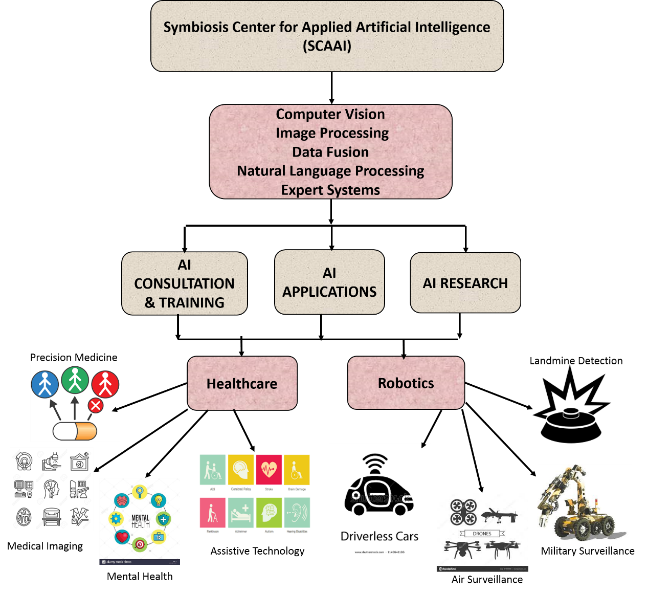
SCAAI
Organization

Slide 3













SCAAI Collaborations
Landmine
Detection
Deep learning. AI
HR Automation
HR Automation
MSF
ROP
ROP
AI+IoT
AI+IoT
Symbiosis Center for Applied AI
Symbiosis Center for Applied AI
Explainable AI (XAI) SPARC Funding)
Explainable AI (XAI) SPARC Funding)
Cystic Fibrosis
Cystic Fibrosis
Autonomous Vehicles
Autonomous Vehicles
Credibility Analysis of Information (CAI) SPARC Funding
Cardio Pulmonary Diseases

